Slide 1

Crime INVESTIGETION Management System.
Student Name : Nikhil Vitthal Kharat
Student Code : fp04_085
IA Name : Nitin Agrawal
Masai School

Slide 2
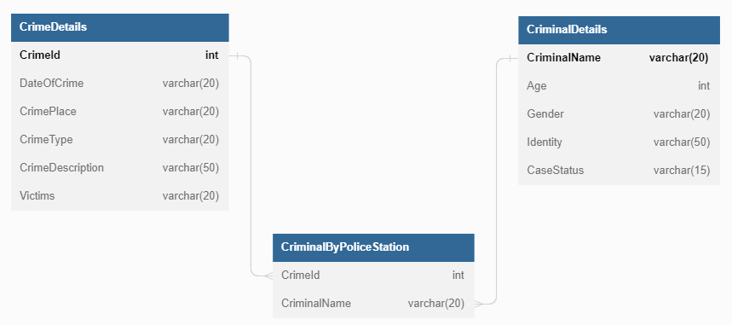
ER Diagram

Slide 3
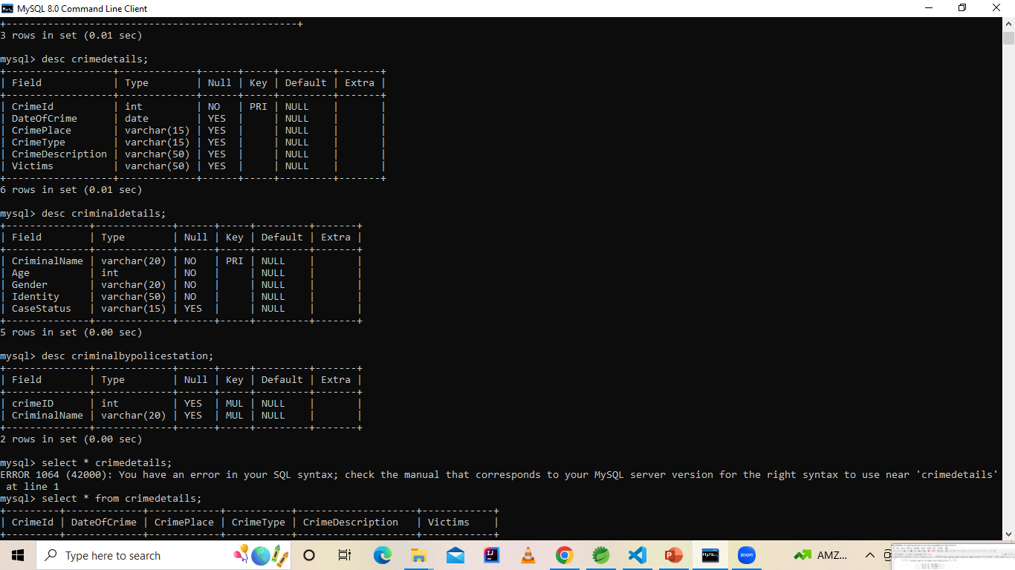
Tables In Sql .

Slide 4
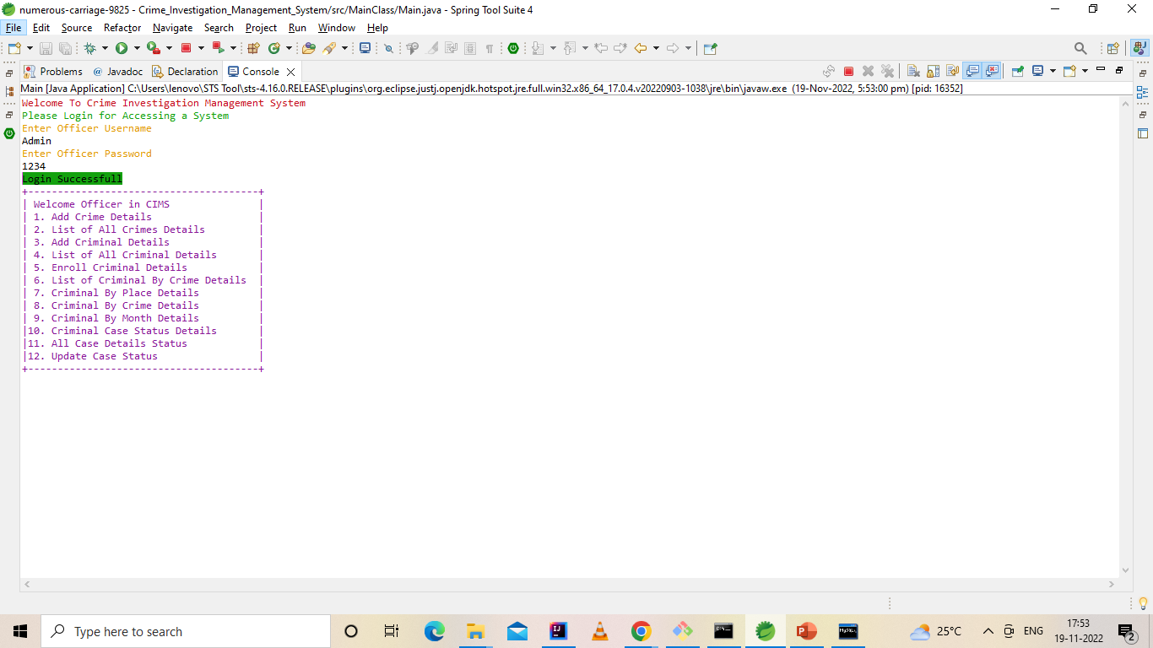
Login page

Slide 5
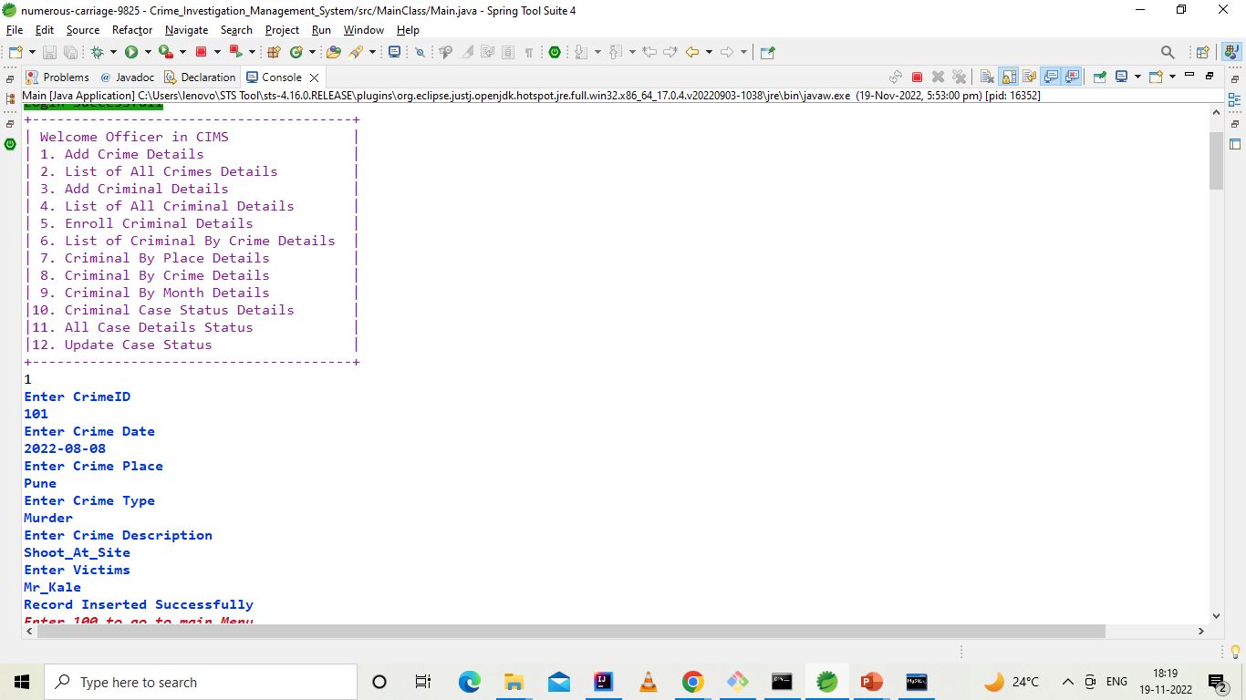
Enter Crime Details

Slide 6
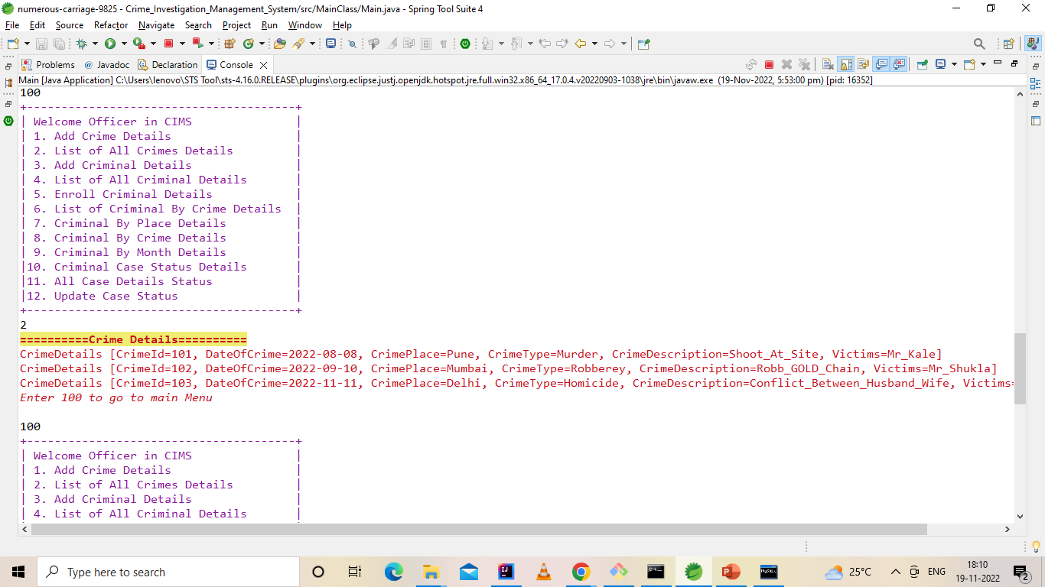
List Of All Crimes Details

Slide 7
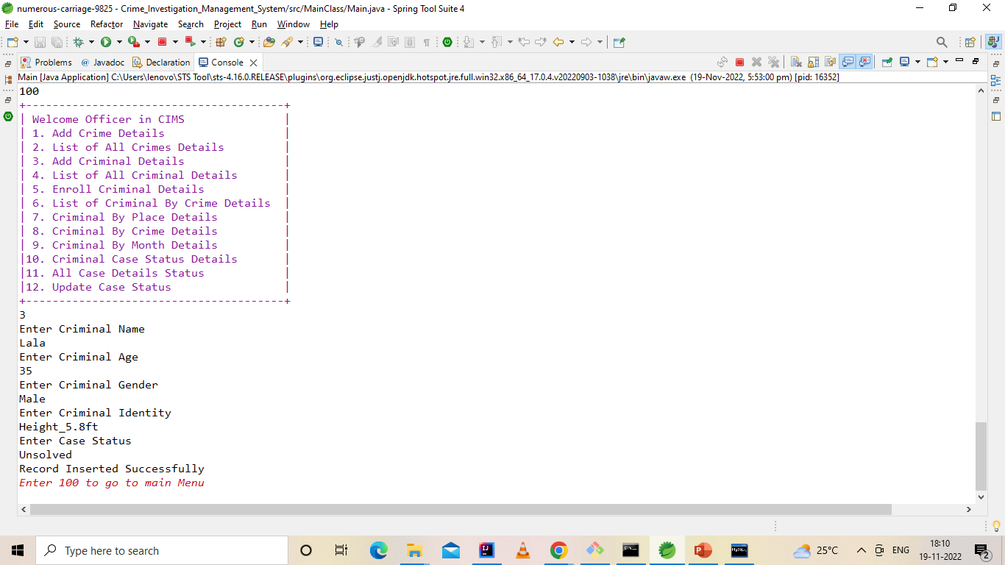
Enter Criminal Details

Slide 8
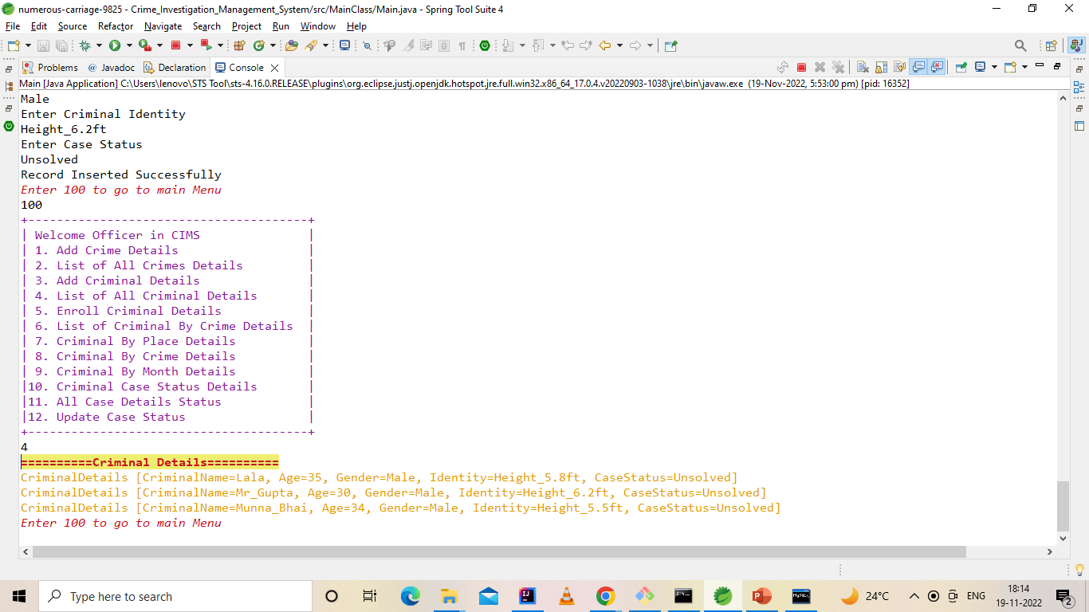
List Of All Criminals Details

Slide 9
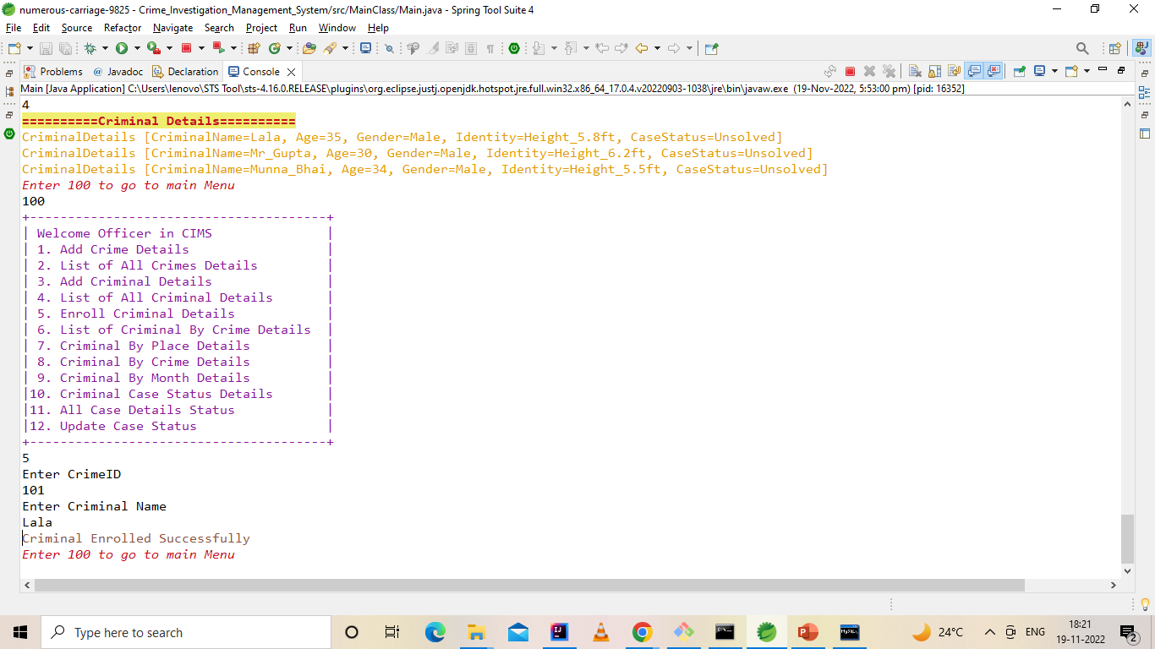
Enrolled Criminal BY ITS Crime Details

Slide 10
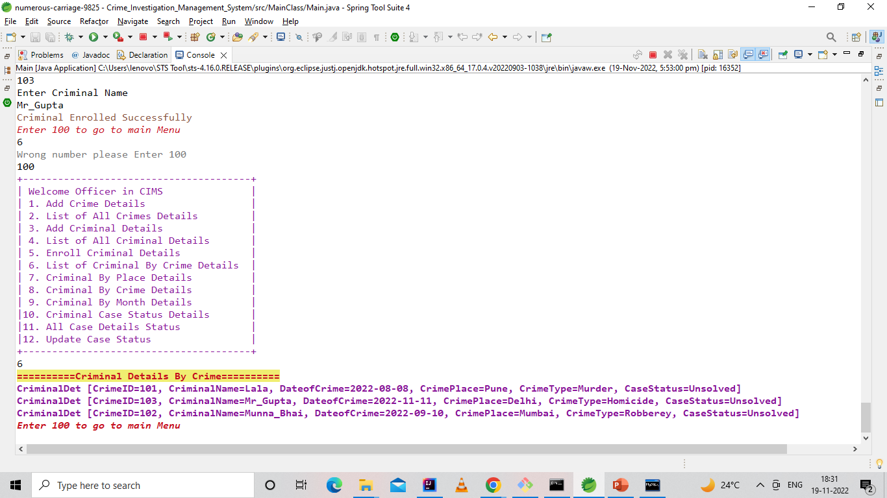
List of Criminal BY ITS Crime Details

Slide 11
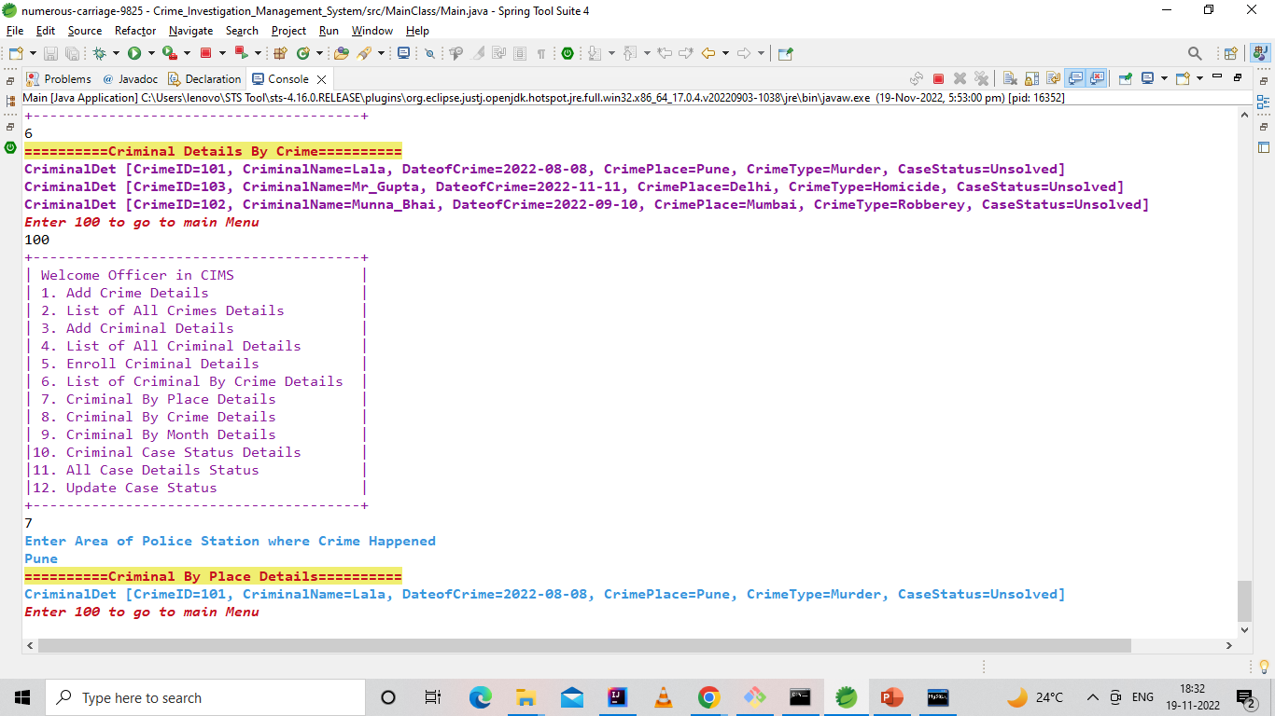
List of Criminal BY ITS Crime PLACE Details

Slide 12
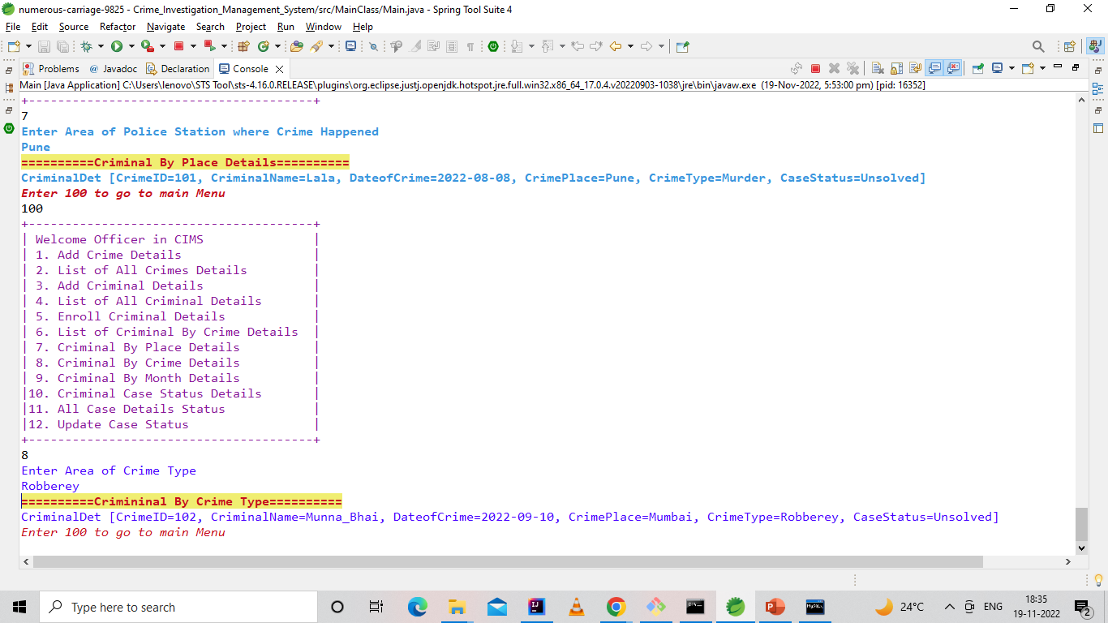
List of Criminal BY ITS Crime Type Details

Slide 13
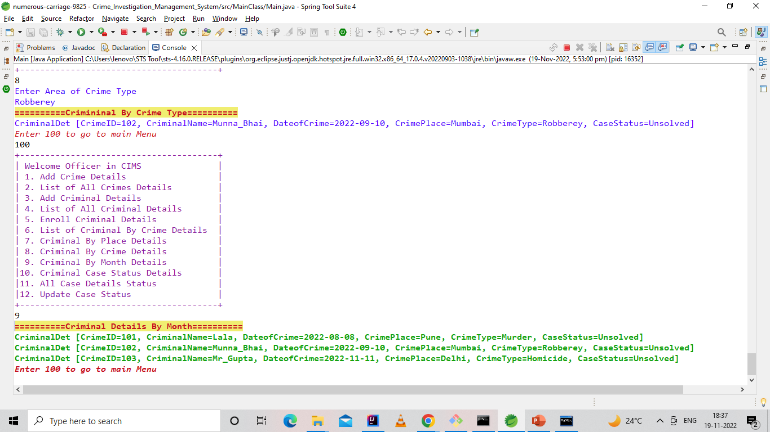
List of Criminal BY ITS Crime Month Wise Details

Slide 14
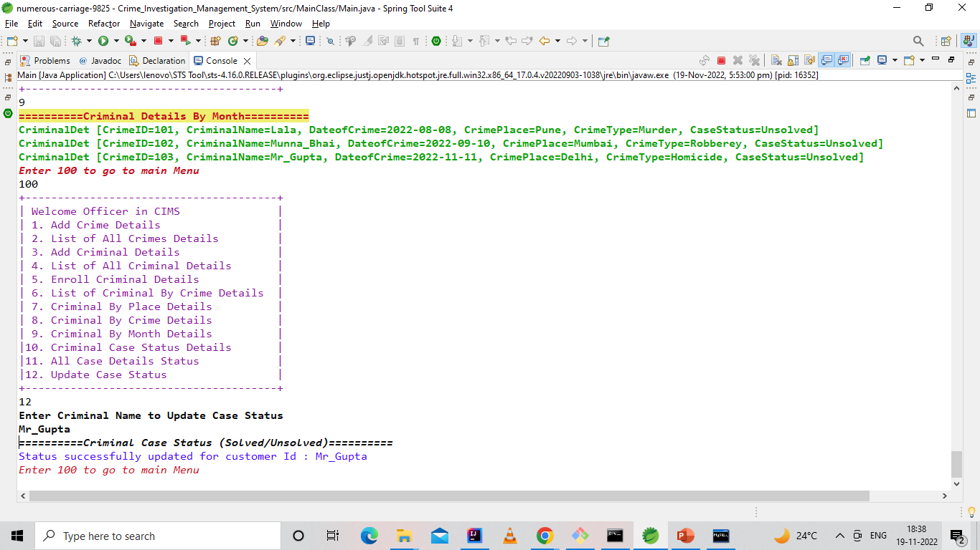
Update case status of criminal

Slide 15
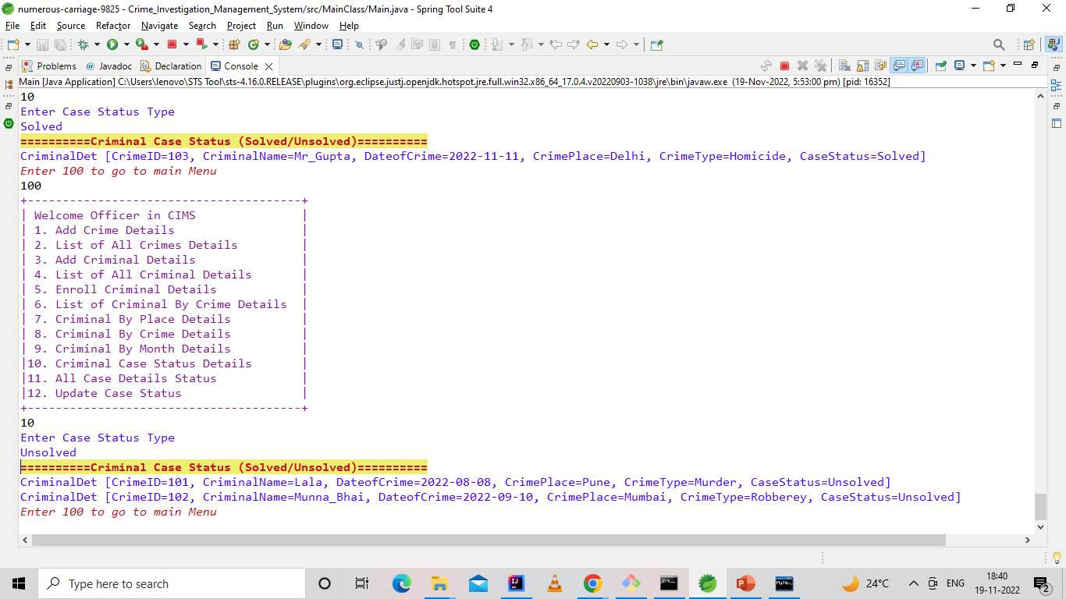
List of Criminal BY ITS Case Status Details

Slide 16
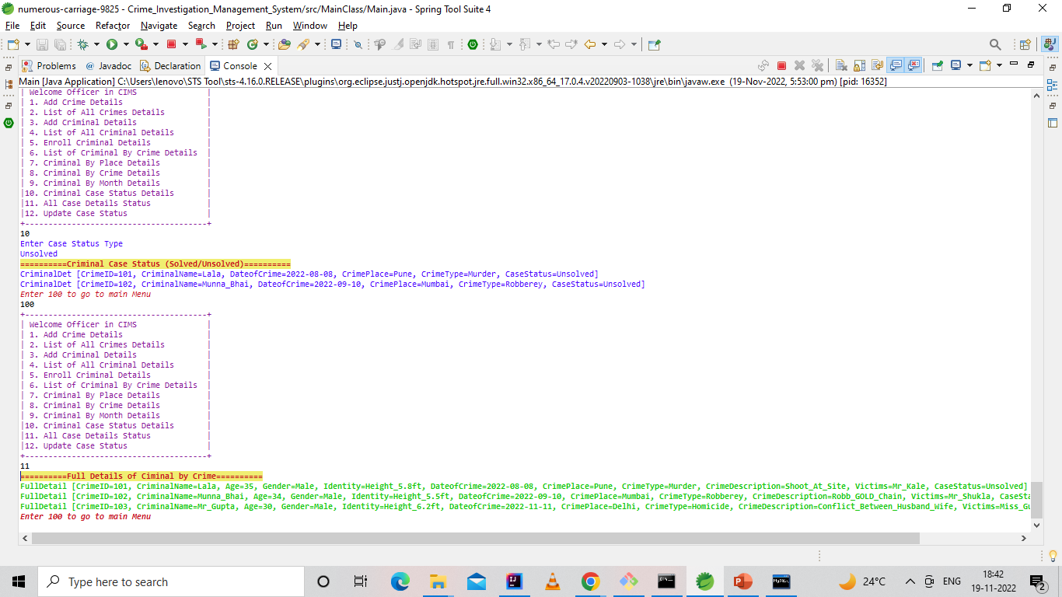
List ALL Case Details

Slide 17
Thank You !!!
Any Question ???
Share Your Valuable Feedback
GitHub ID= https://github.com/nikhilkharat
LINKDIN ID=https://www.linkedin.com/in/nikhil-kharat-872608109

